Slide 1
Logistic Regression/Classification
Jun Hong

Slide 2
In this week’s lecture
Basics of logistic regression/classification
What is logistic regression
Logistic regression needs a different model from linear regression, including a new cost function
What’s decision boundary
How to train a logistic regression model
How to use gradient descent to train a logistic regression model

Slide 3
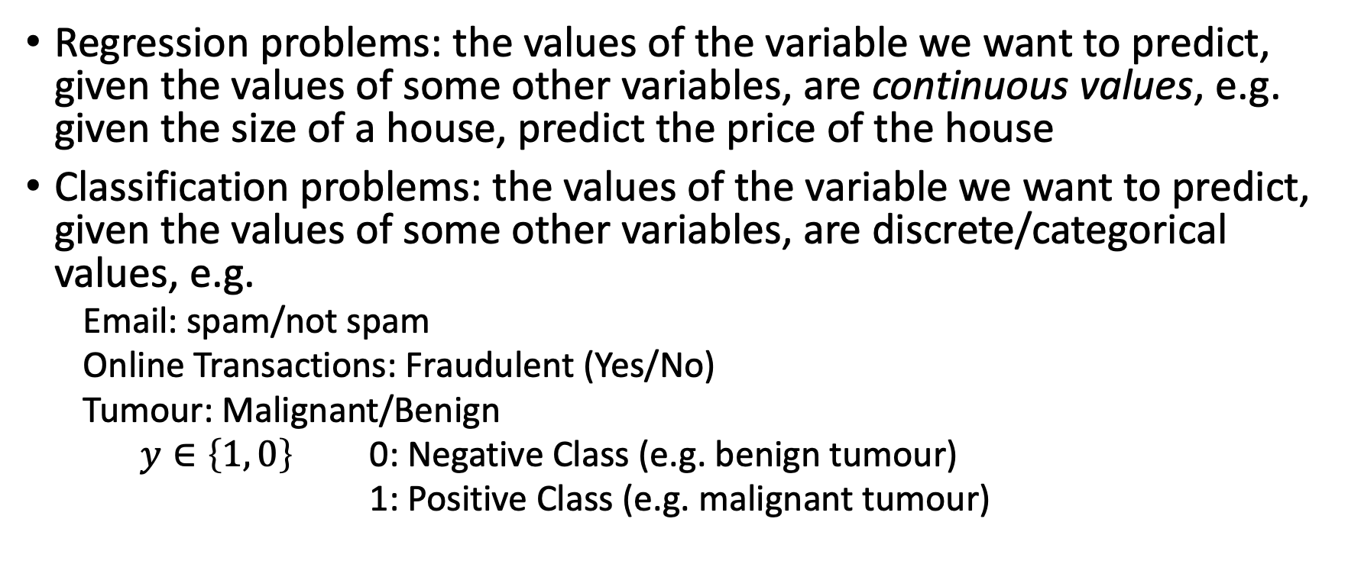
Classification versus Regression
Regression problems: the values of the variable we want to predict, given the values of some other variables, are continuous values, e.g. given the size of a house, predict the price of the house
Classification problems: the values of the variable we want to predict, given the values of some other variables, are discrete/categorical values, e.g.
  Email: spam/not spam
  Online Transactions: Fraudulent (Yes/No)
  Tumour: Malignant/Benign
  $y∈\left\{1, 0\right\}$ 0: Negative Class (e.g. benign tumour)
  1: Positive Class (e.g. malignant tumour)

Slide 4
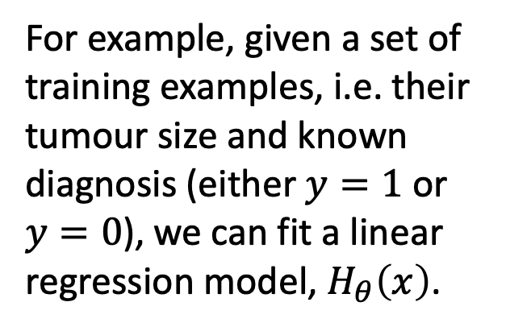


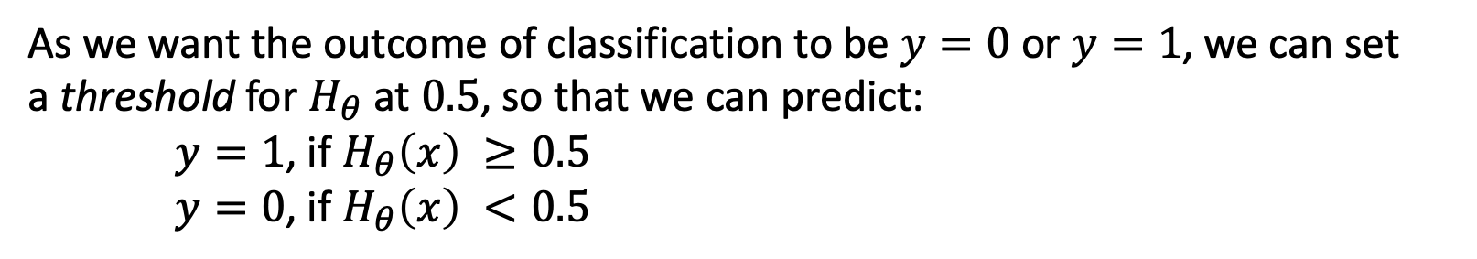


Is It Possible to Use Linear Regression for Classification?
$$H_{θ}\left(x\right)=θ^{T}x$$
For example, given a set of training examples, i.e. their tumour size and known diagnosis (either $y=1$ or $y=0$), we can fit a linear regression model, $H_{θ}\left(x\right)$.
(Yes) $1$
✕ ✕ ✕ ✕
Malignant?
$$0.5$$
(No) $0$
✕ ✕ ✕ ✕
Tumour Size
As we want the outcome of classification to be $y=0$ or $y=1$, we can set
a threshold for $H_{θ}$ at $0.5$, so that we can predict:
$y=1$, if $H_{θ}\left(x\right) ≥0.5$
$y=0$, if $H_{θ}\left(x\right) <0.5$
Notes:
The predicted value is a continuous value.

Slide 5
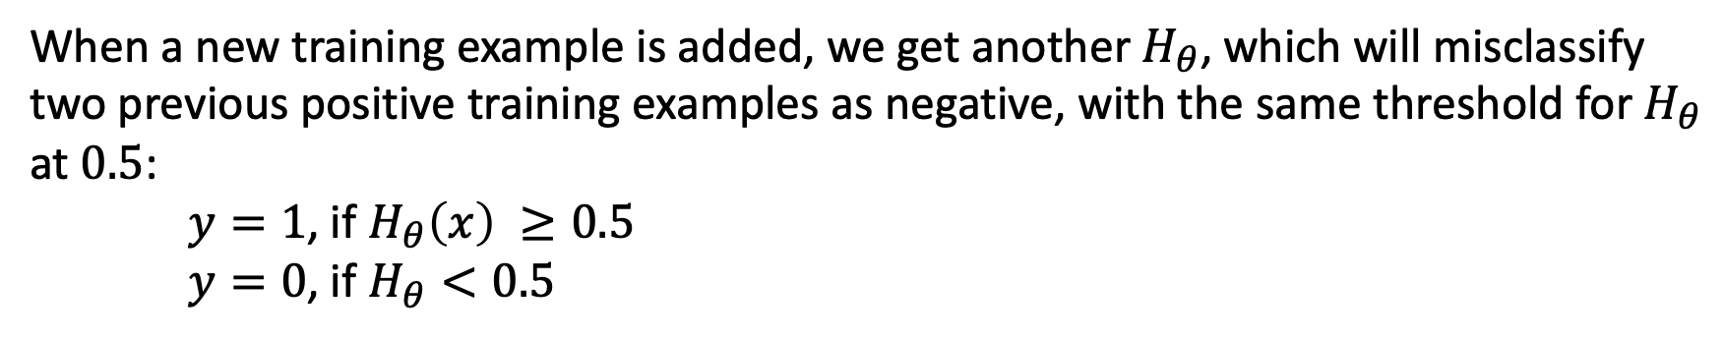

Using Linear Regression for Classification Is Not a Great Idea – One Problem
$$H_{θ}\left(x\right)=θ^{T}x$$
(Yes) $1$
✕ ✕ ✕ ✕
✕
Malignant?
$$0.5$$
(No) $0$
✕ ✕ ✕ ✕
Tumour Size
When a new training example is added, we get another $H_{θ}$, which will misclassify two previous positive training examples as negative, with the same threshold for $H_{θ}$ at $0.5$:
$y=1$, if $H_{θ}\left(x\right) ≥0.5$
$y=0$, if $H_{θ}<0.5$

Slide 6
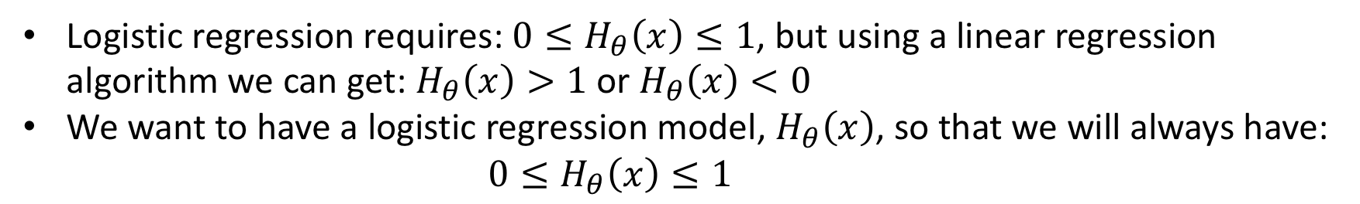
Using Linear Regression for Classification Is Not a Great Idea – Another Problem
$$H_{θ}\left(x\right)=θ^{T}x$$
(Yes) $1$
✕ ✕ ✕ ✕
✕
Malignant?
$$0.5$$
(No) $0$
✕ ✕ ✕ ✕
Tumour Size
Logistic regression requires: ${0≤H}_{θ}\left(x\right)≤1$, but using a linear regression algorithm we can get: $H_{θ}\left(x\right)>1$ or $H_{θ}\left(x\right)<0$
We want to have a logistic regression model, $H_{θ}\left(x\right)$, so that we will always have: ${0≤H}_{θ}\left(x\right)≤1$

Slide 7
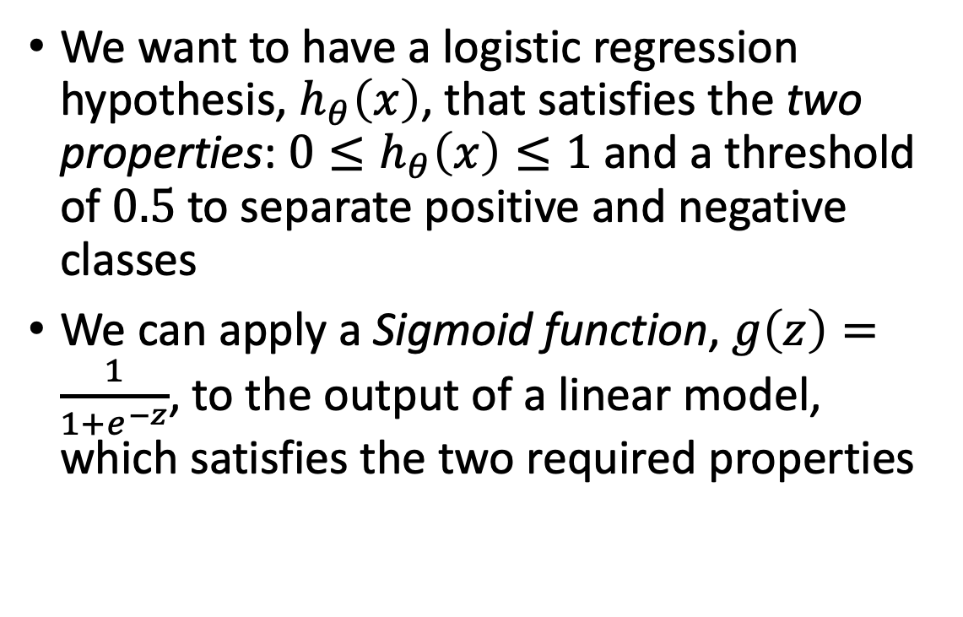
Logistic Regression Model – Hypothesis Representation
We want to have a logistic regression hypothesis, $h_{θ}\left(x\right)$, that satisfies the two properties: ${0≤h}_{θ}\left(x\right)≤1$ and a threshold of $0.5$ to separate positive and negative classes
We can apply a Sigmoid function, $g\left(z\right)=\frac{1}{1+e^{−z}}$, to the output of a linear model, which satisfies the two required properties
Notes:
All figures are illustrated in plot-logistic.ipynb.

Slide 8
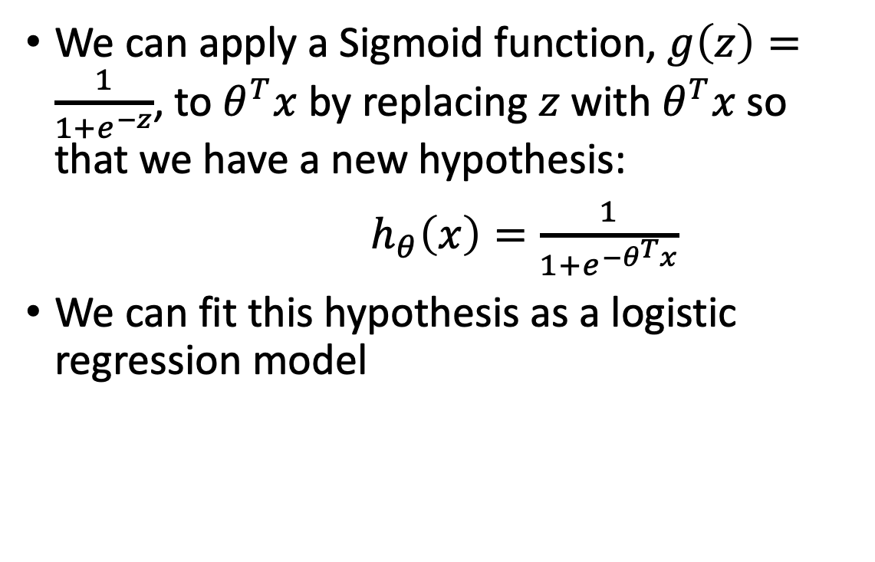

Logistic Regression Model – Hypothesis Representation
We can apply a Sigmoid function, $g\left(z\right)=\frac{1}{1+e^{−z}}$, to $θ^{T}x$ by replacing $z$ with $θ^{T}x$so that we have a new hypothesis:
$h_{θ}\left(x\right)=\frac{1}{1+e^{−θ^{T}x}}$
We can fit this hypothesis as a logistic regression model
The function for logistic regression is actual a combination
of two functions, the linear function for liner regression
and the sigmoid function.
Note that when $θ^{T}x=0$, $h_{θ}\left(x\right)=0.5$

Slide 9
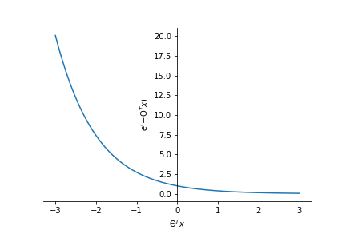
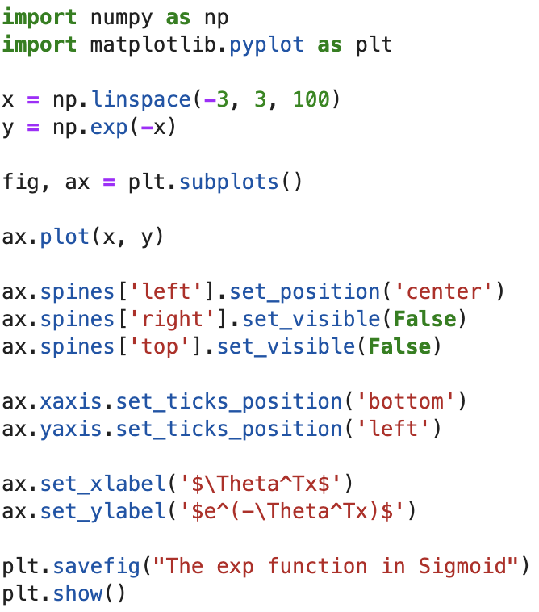

How Does $e^{−θ^{T}x}$ Work?

Slide 10
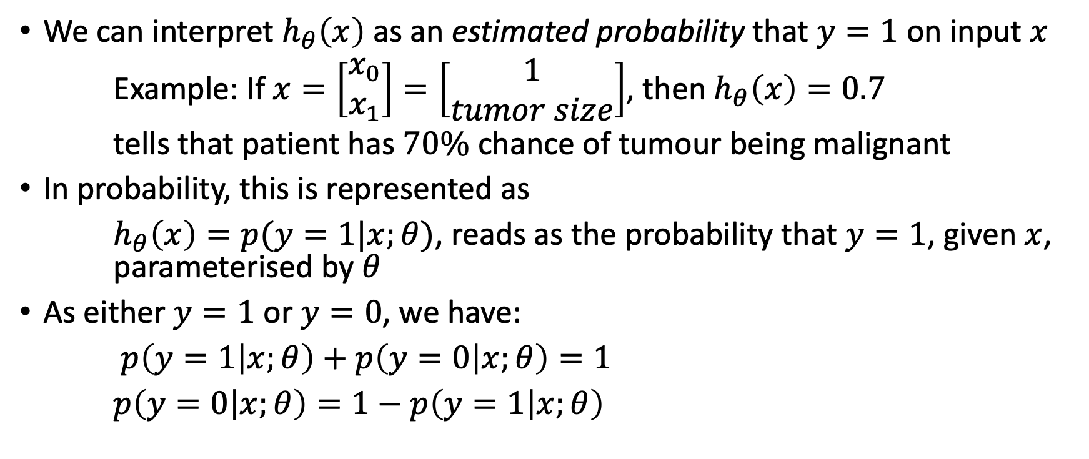
Interpretation of Model Output
We can interpret $h_{θ}\left(x\right)$ as an estimated probability that $y=1$ on input $x$
Example: If $x=\left[\begin{matrix}x_{0} \\ x_{1}\end{matrix}\right]=\left[\begin{matrix}1 \\ tumor size\end{matrix}\right]$, then $h_{θ}\left(x\right)=0.7$
tells that patient has $70\%$ chance of tumour being malignant
In probability, this is represented as
$h_{θ}\left(x\right)=p(y=1|x;θ)$, reads as the probability that $y=1$, given $x$, parameterised by $θ$
As either $y=1$ or $y=0$, we have:
$p\left(y=1 | x;θ\right)+p\left(y=0 | x;θ\right)=1$
$p\left(y=0 | x;θ\right)=1−p\left(y=1 | x;θ\right)$

Slide 11
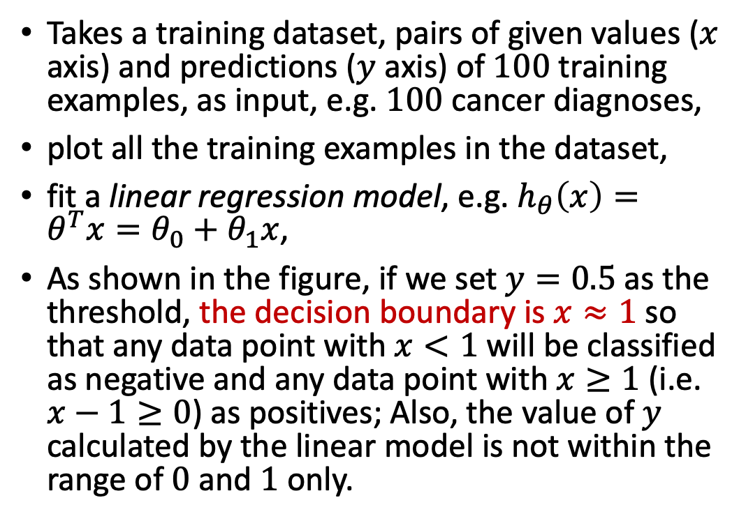
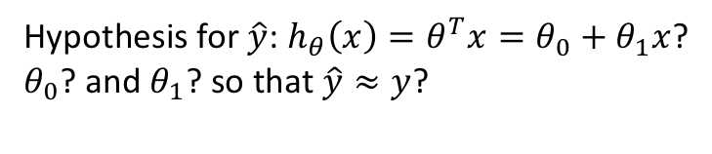
Logistic Regression – An Example
Takes a training dataset, pairs of given values ($x$ axis) and predictions ($y$ axis) of $100$ training examples, as input, e.g. $100$ cancer diagnoses,
plot all the training examples in the dataset,
fit a linear regression model, e.g. $h_{θ}\left(x\right)=θ^{T}x=θ_{0}+θ_{1}x$,
As shown in the figure, if we set $y=0.5$ as the threshold, the decision boundary is $x≈1$so that any data point with $x<1$ will be classified as negative and any data point with $x≥1$ (i.e. $x−1≥0$) as positives; Also, the value of $y$ calculated by the linear model is not within the range of $0$ and $1$ only.
Hypothesis for $\hat{y}$: $h_{θ}\left(x\right)={θ^{T}x=θ}_{0}+θ_{1}x$?
$θ_{0}$? and $θ_{1}$? so that $\hat{y}≈y$?
Notes:
The model misclassifies some positive training examples.

Slide 12
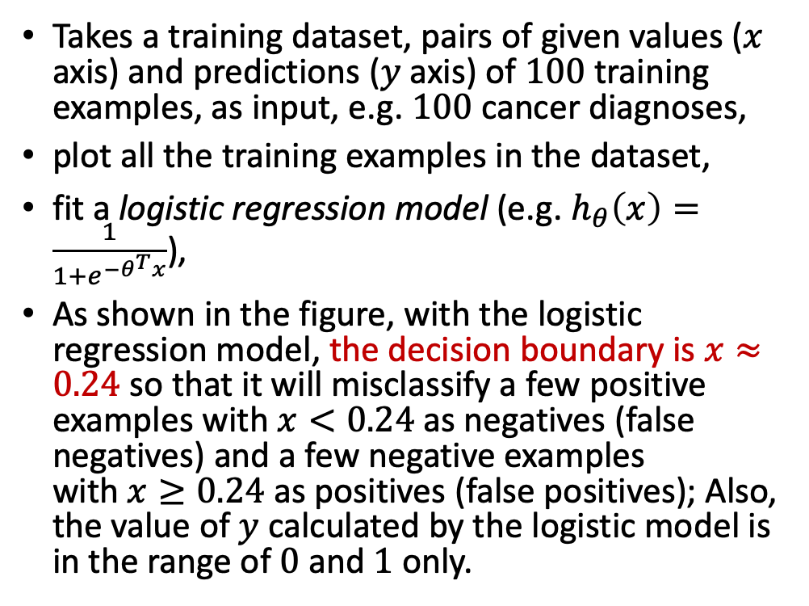
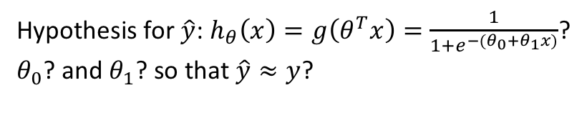
Logistic Regression – An Example
Takes a training dataset, pairs of given values ($x$ axis) and predictions ($y$ axis) of $100$ training examples, as input, e.g. $100$ cancer diagnoses,
plot all the training examples in the dataset,
fit a logistic regression model (e.g. $h_{θ}\left(x\right)=\frac{1}{1+e^{−θ^{T}x}}$),
As shown in the figure, with the logistic regression model, the decision boundary is $x≈0.24$ so that it will misclassify a few positive examples with $x<0.24$ as negatives (false negatives) and a few negative examples with $x≥0.24$ as positives (false positives); Also, the value of $y$ calculated by the logistic model is in the range of $0$ and $1$ only.
Hypothesis for $\hat{y}$: $h_{θ}\left(x\right)=g\left(θ^{T}x\right)=$ $\frac{1}{1+e^{−{(θ}_{0}+θ_{1}x)}}$?
$θ_{0}$? and $θ_{1}$? so that $\hat{y}≈y$?
Notes:
The model misclassifies much less positive training examples though misclassifies a few negative examples.

Slide 13
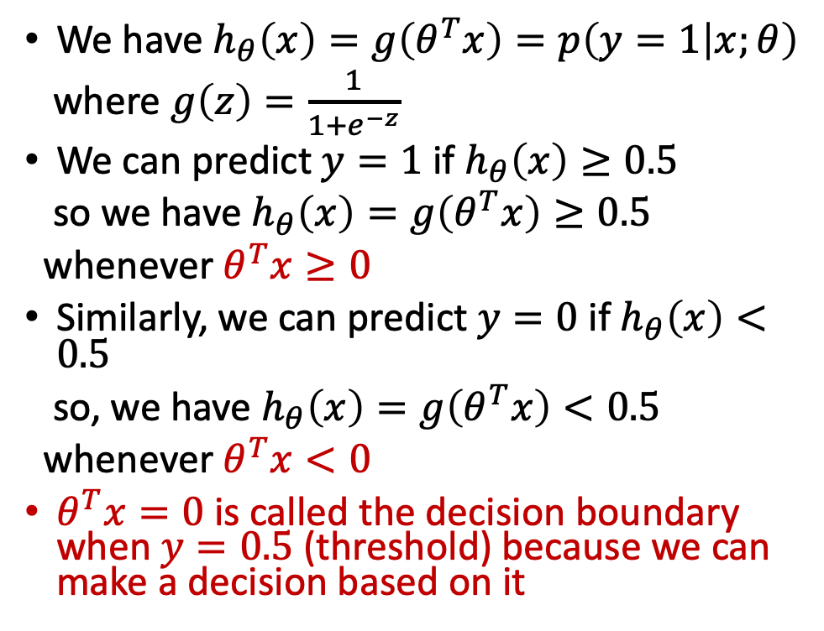
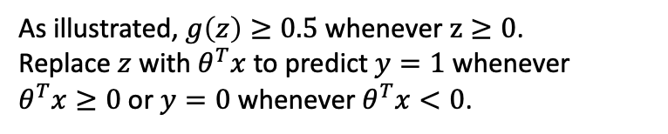
Logistic Regression – Decision Boundary
We have $h_{θ}\left(x\right)=g\left(θ^{T}x\right)=p\left(y=1 | x;θ\right)$
where $g\left(z\right)=\frac{1}{1+e^{−z}}$
We can predict $y=1$ if $h_{θ}\left(x\right)≥0.5$
so we have $h_{θ}\left(x\right)=g\left(θ^{T}x\right)≥0.5$
whenever $θ^{T}x≥0$
Similarly, we can predict $y=0$ if $h_{θ}\left(x\right)<0.5$
so, we have $h_{θ}\left(x\right)=g\left(θ^{T}x\right)<0.5$
whenever $θ^{T}x<0$
$θ^{T}x=0$ is called the decision boundary when$y=0.5$ (threshold) because we can make a decision based on it
As illustrated, $g\left(z\right)≥0.5$ whenever $z≥0$.
Replace $z$ with $θ^{T}x$ to predict $y=1$ whenever $θ^{T}x≥0$or $y=0$ whenever $θ^{T}x<0$.

Slide 14
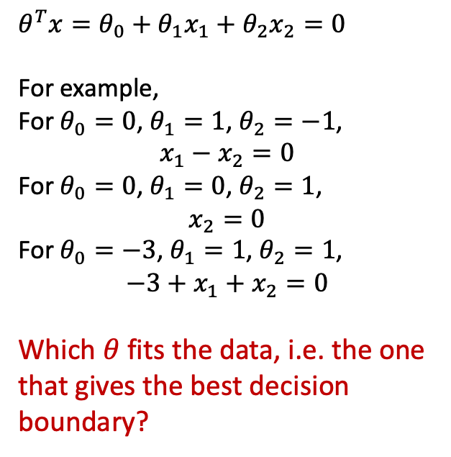
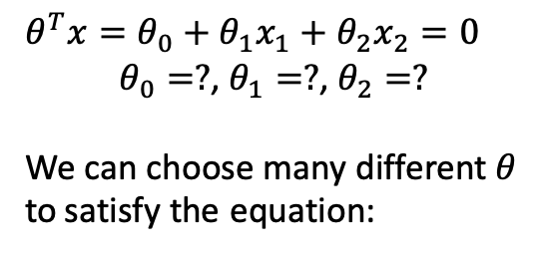
How to Find the Decision Boundary?
$θ^{T}x=θ_{0}+θ_{1}x_{1}+θ_{2}x_{2}=0$
$θ_{0}=?$, $θ_{1}=?$, $θ_{2}=?$
We can choose many different $θ$
to satisfy the equation:
$θ^{T}x=θ_{0}+θ_{1}x_{1}+θ_{2}x_{2}=0$
For example,
For $θ_{0}=0$, $θ_{1}=1$, $θ_{2}=−1$,
$$x_{1}−x_{2}=0$$
For $θ_{0}=0$, $θ_{1}=0$, $θ_{2}=1$,
$$x_{2}=0$$
For $θ_{0}=−3$, $θ_{1}=1$, $θ_{2}=1$,
$${−3+x}_{1}+x_{2}=0$$
Which $θ$ fits the data, i.e. the one
that gives the best decision
boundary?
Notes:
When a model is trained, we have a set of values for the parameters thetas. Using these values, we can find the decision boundary which is a linear equation.
A decision boundary consists of a set of values for $x$ so that $h_{θ}\left(x\right)=0.5$ (i.e. threshold) after $h_{θ}\left(x\right)$ is trained (i.e. a set of values for theta .

Slide 15
End of Week 2

Slide 16
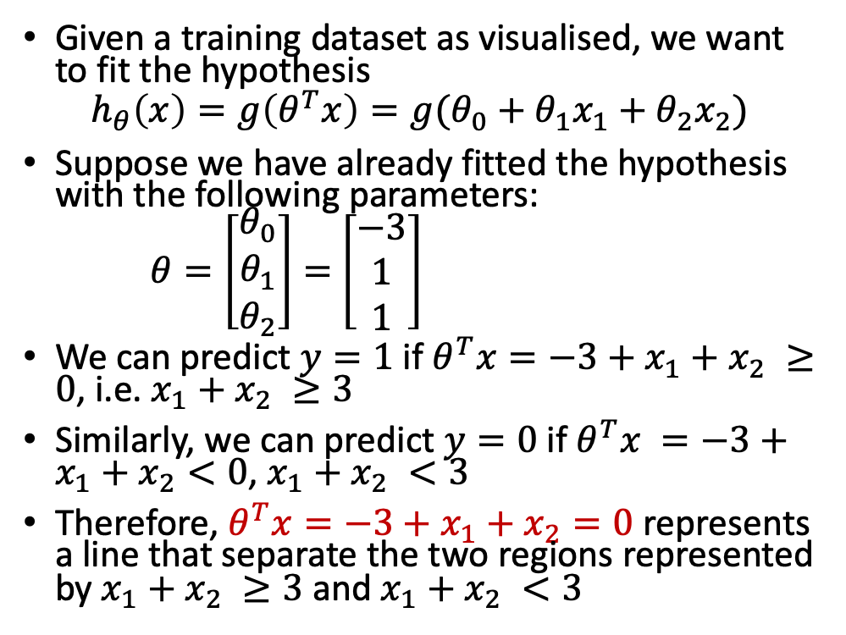
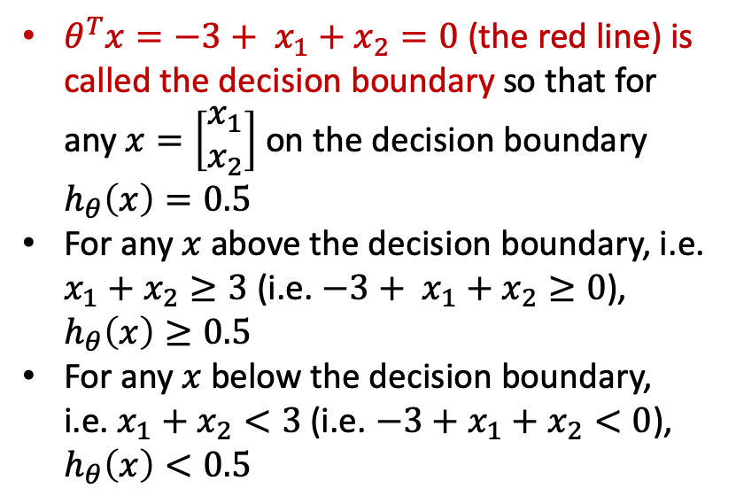
Logistic Regression – Decision Boundary
Given a training dataset as visualised, we want to fit the hypothesis
$$h_{θ}\left(x\right)=g\left(θ^{T}x\right)=g(θ_{0}+θ_{1}x_{1}+θ_{2}x_{2})$$
Suppose we have already fitted the hypothesis with the following parameters:
$θ=\left[\begin{matrix}θ_{0} \\ θ_{1} \\ θ_{2}\end{matrix}\right]=$ $\left[\begin{matrix}−3 \\ 1 \\ 1\end{matrix}\right]$
We can predict $y=1$ if $θ^{T}x=−3+x_{1}+x_{2} ≥0$, i.e. $x_{1}+x_{2} ≥3$
Similarly, we can predict $y=0$ if $θ^{T}x =−3+x_{1}+x_{2}<0$, $x_{1}+x_{2} <3$
Therefore, ${θ^{T}x=−3+x}_{1}+x_{2}=0$ represents a line that separate the two regions represented by $x_{1}+x_{2} ≥3$ and $x_{1}+x_{2} <3$
${θ^{T}x=−3+ x}_{1}+x_{2}=0$ (the red line) is called the decision boundary so that for any $x=\left[\begin{matrix}x_{1} \\ x_{2}\end{matrix}\right]$ on the decision boundary $h_{θ}\left(x\right)=0.5$
For any $x$ above the decision boundary, i.e. $x_{1}+x_{2}≥3$ (i.e. ${−3+ x}_{1}+x_{2}≥0$), $h_{θ}\left(x\right)≥0.5$
For any $x$ below the decision boundary, i.e. $x_{1}+x_{2}<3$ (i.e. $−3+x_{1}+x_{2}<0$), $h_{θ}\left(x\right)<0.5$
Notes:
Note that the decision boundary depends on the parameters only. So once the model is trained, the decision boundary can be calculated.
We can use the two intercepts on $x_{1}$ and $x_{2}$ to plot the line. For example, we have one intercept at $x_{1}=0$, $x_{2}=3$ and another intercept $x_{1}=3$, $x_{2}=0$.

Slide 17
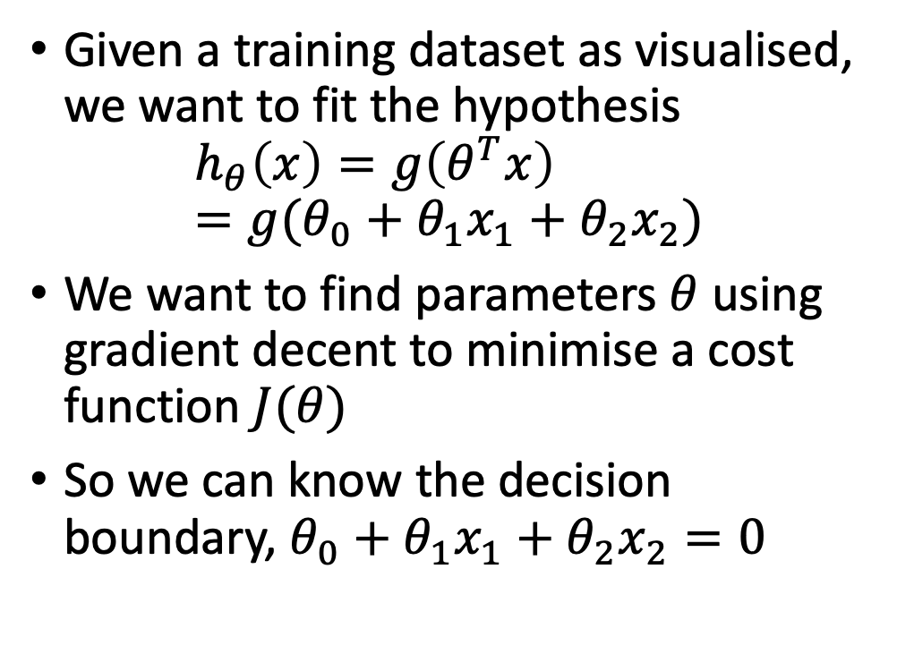
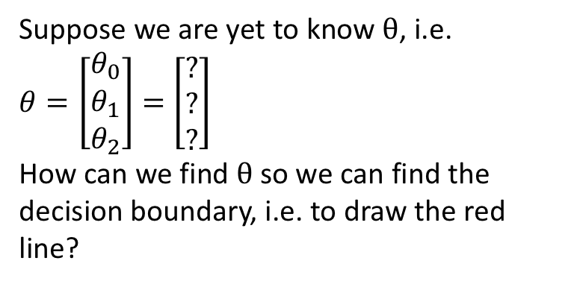
Logistic Regression – Fitting the Model
Given a training dataset as visualised, we want to fit the hypothesis
$$h_{θ}\left(x\right)=g\left(θ^{T}x\right)=g(θ_{0}+θ_{1}x_{1}+θ_{2}x_{2})$$
We want to find parameters $θ$ using gradient decent to minimise a cost function $J(θ)$
So we can know the decision boundary, $θ_{0}+θ_{1}x_{1}+θ_{2}x_{2}=0$
?
Suppose we are yet to know $θ$, i.e.
$θ=\left[\begin{matrix}θ_{0} \\ θ_{1} \\ θ_{2}\end{matrix}\right]=$ $\left[\begin{matrix}? \\ ? \\ ?\end{matrix}\right]$
How can we find $θ$ so we can find the decision boundary, i.e. to draw the red line?
Notes:
Co-efficients and intersects.

Slide 18
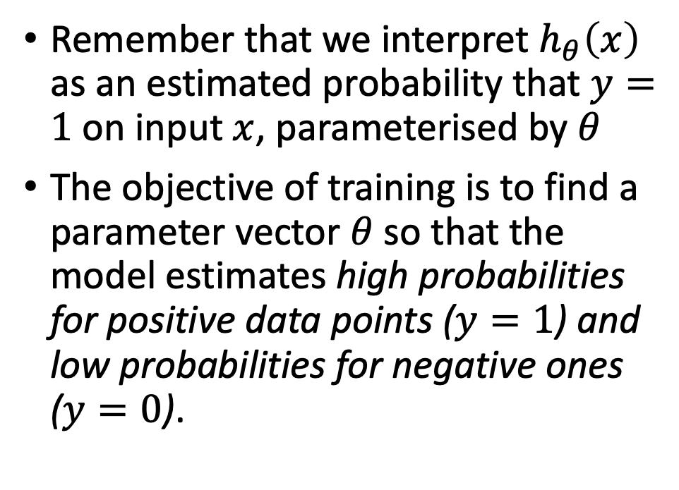
Fitting the Model – the objective
Remember that we interpret $h_{θ}\left(x\right)$ as an estimated probability that $y=1$ on input $x$, parameterised by $θ$
The objective of training is to find a parameter vector $θ$ so that the model estimates high probabilities for positive data points ($y=1$) and low probabilities for negative ones ($y=0$).

Slide 19
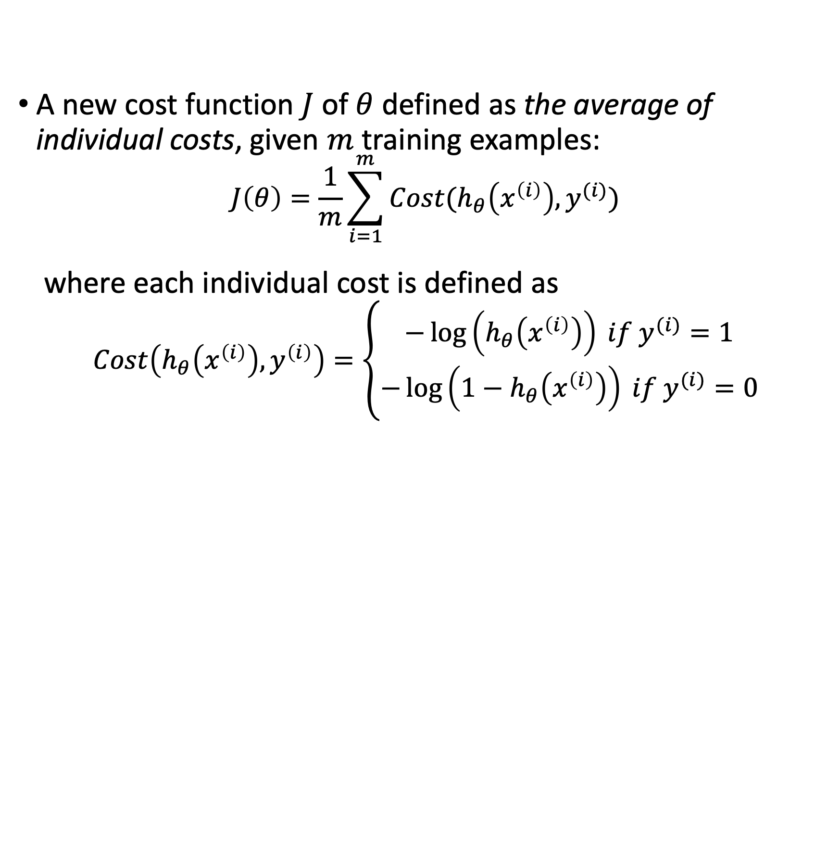
Cost Function for Logistic Regression
A new cost function $J$ of $θ$ defined as the average of individual costs, given $m$ training examples:
$$J\left(θ\right)=\frac{1}{m}{\sum_{i=1}^{m}{Cost(h_{θ}\left(x^{\left(i\right)}\right),y^{(i)})}}$$
where each individual cost is defined as
$$Cost\left(h_{θ}\left(x^{\left(i\right)}\right),y^{\left(i\right)}\right)=\left\{\begin{aligned}−\log\left(h_{θ}\left(x^{\left(i\right)}\right)\right) if y^{(i)}=1 \\ −\log\left({1−h}_{θ}\left(x^{\left(i\right)}\right)\right) if y^{(i)}=0\end{aligned}\right.$$

Slide 20
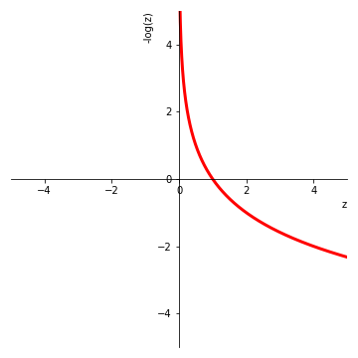
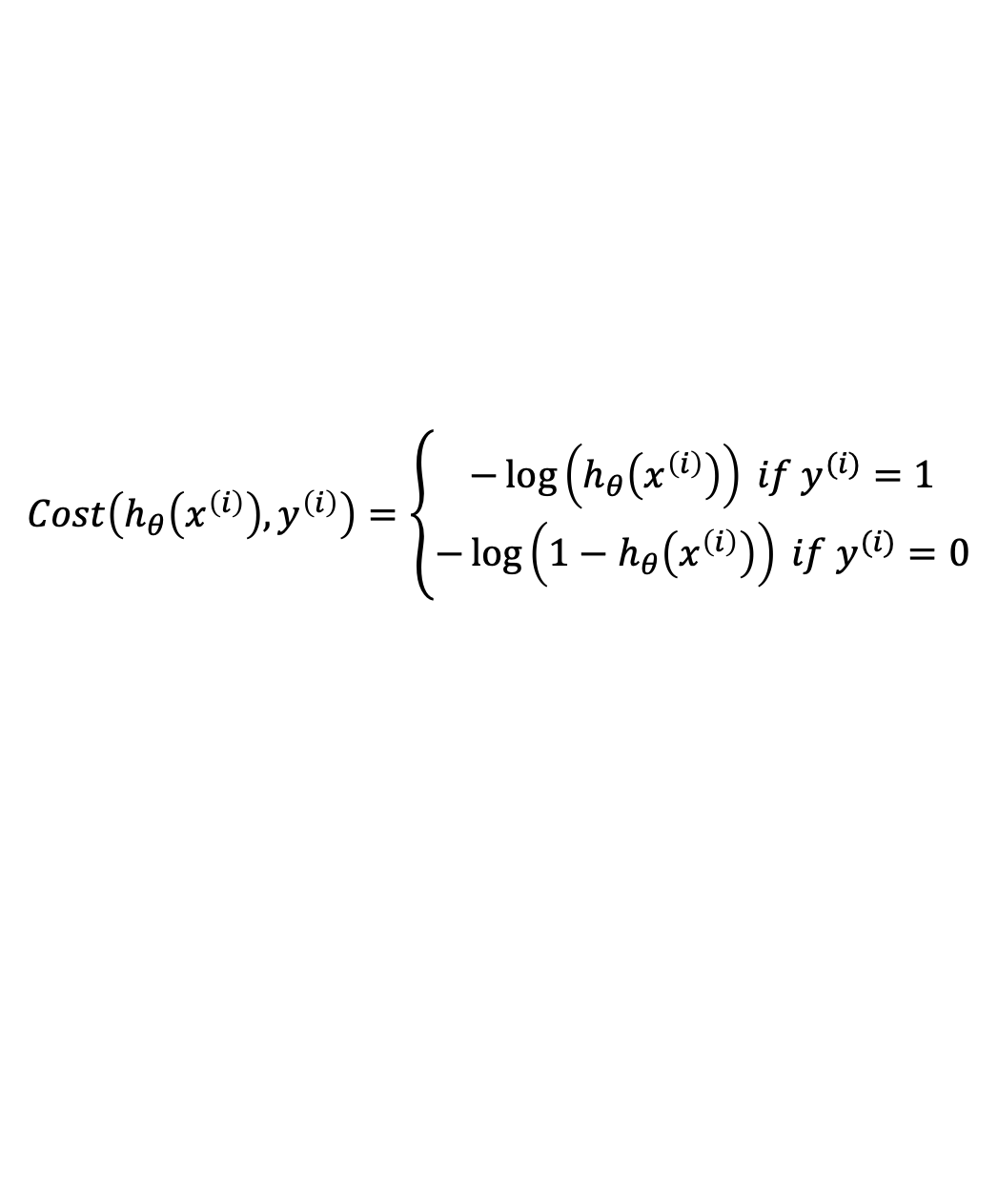
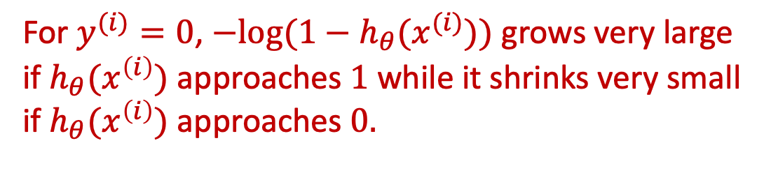
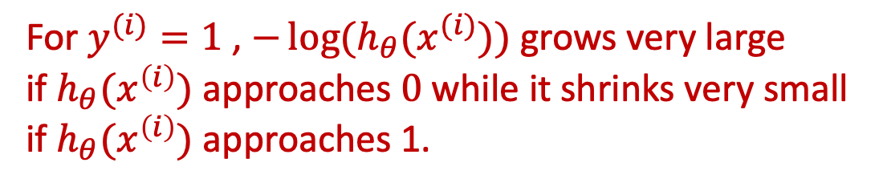
Intuition of Cost Function
$$Cost\left(h_{θ}\left(x^{\left(i\right)}\right),y^{\left(i\right)}\right)=\left\{\begin{aligned}−\log\left(h_{θ}\left(x^{\left(i\right)}\right)\right) if y^{(i)}=1 \\ −\log\left({1−h}_{θ}\left(x^{\left(i\right)}\right)\right) if y^{(i)}=0\end{aligned}\right.$$
For $y^{(i)}=1$ , $−\log{(h_{θ}(x^{(i)}))}$ grows very large
if $h_{θ}(x^{\left(i\right)})$ approaches $0$while it shrinks very small
if $h_{θ}(x^{\left(i\right)})$ approaches 1.
For $y^{(i)}=0$, $−log({1−h}_{θ}(x^{(i)}))$ grows very large
if $h_{θ}(x^{\left(i\right)})$ approaches $1$ while it shrinks very small
if $h_{θ}(x^{\left(i\right)})$ approaches $0.$

Slide 21
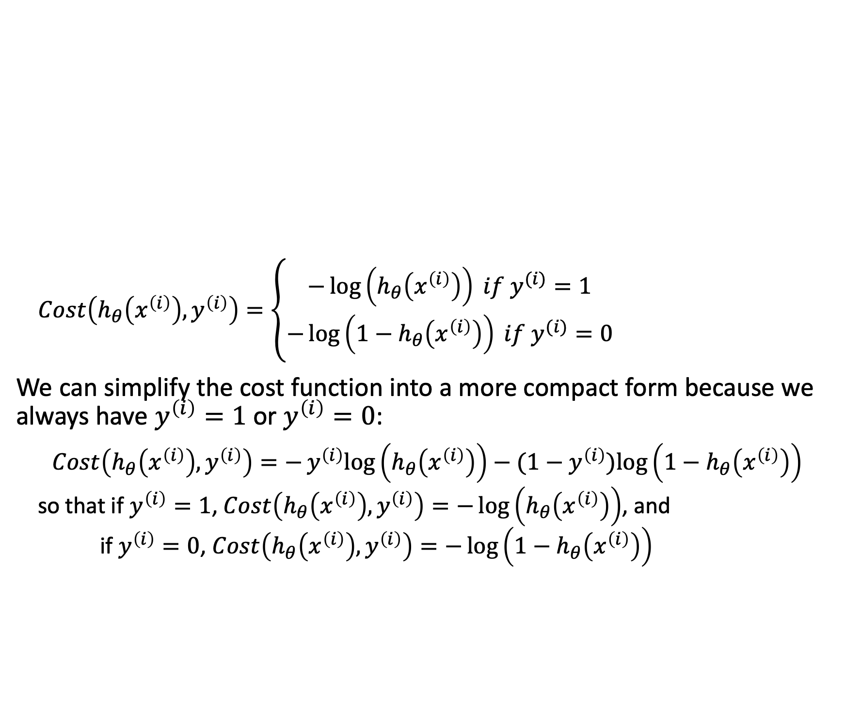
Cost Function for Logistic Regression
$Cost\left(h_{θ}\left(x^{\left(i\right)}\right),y^{\left(i\right)}\right)=\left\{\begin{aligned}−\log\left(h_{θ}\left(x^{\left(i\right)}\right)\right) if y^{(i)}=1 \\ −\log\left({1−h}_{θ}\left(x^{\left(i\right)}\right)\right) if y^{(i)}=0\end{aligned}\right.$
We can simplify the cost function into a more compact form because we always have $y^{\left(i\right)}=1$or $y^{\left(i\right)}=0$:
$$Cost\left(h_{θ}\left(x^{\left(i\right)}\right),y^{\left(i\right)}\right)=−y^{\left(i\right)}log\left(h_{θ}\left(x^{\left(i\right)}\right)\right)−(1−y^{\left(i\right)})log\left({1−h}_{θ}\left(x^{\left(i\right)}\right)\right)$$
so that if $y^{\left(i\right)}=1$, $Cost\left(h_{θ}\left(x^{\left(i\right)}\right),y^{\left(i\right)}\right)=−\log\left(h_{θ}\left(x^{\left(i\right)}\right)\right)$, and
if $y^{\left(i\right)}=0$, $Cost\left(h_{θ}\left(x^{\left(i\right)}\right),y^{\left(i\right)}\right)=−\log\left({1−h}_{θ}\left(x^{\left(i\right)}\right)\right)$

Slide 22
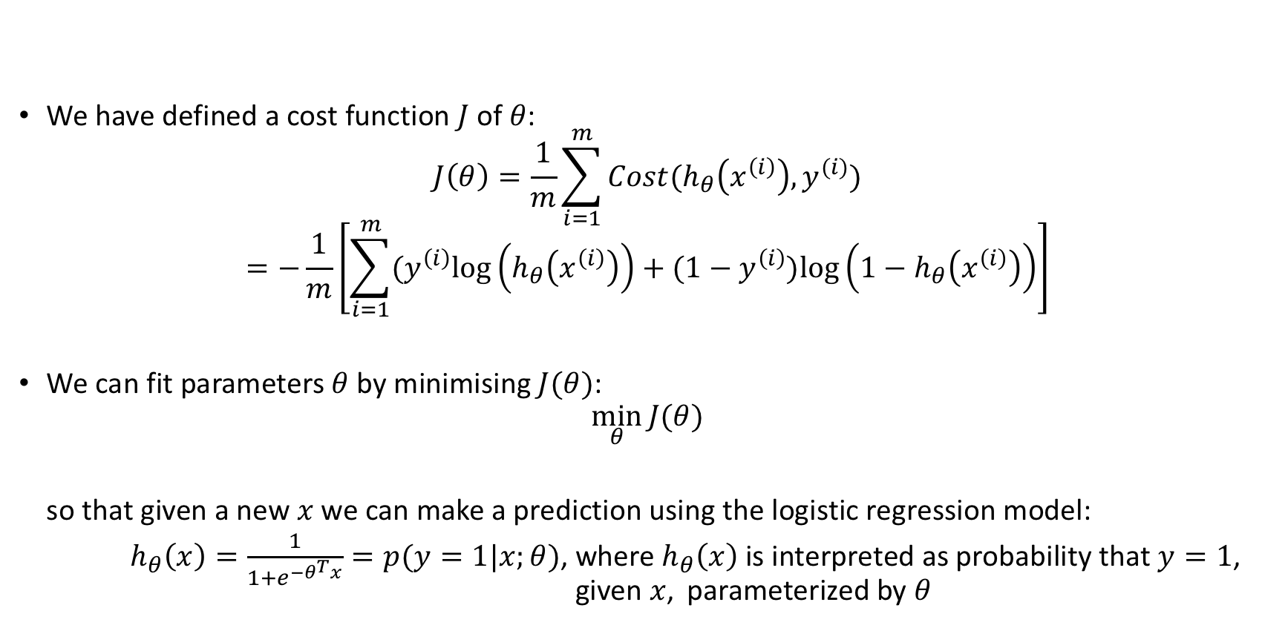

Choosing $θ$ to Minimise Cost Function
We have defined a cost function $J$ of $θ$:
$$J\left(θ\right)=\frac{1}{m}{\sum_{i=1}^{m}{Cost(h_{θ}\left(x^{\left(i\right)}\right),y^{(i)})}}$$
$$=−\frac{1}{m}\left[\sum_{i=1}^{m}{(y^{\left(i\right)}log\left(h_{θ}\left(x^{\left(i\right)}\right)\right)+(1−y^{\left(i\right)})log\left({1−h}_{θ}\left(x^{\left(i\right)}\right)\right)}\right]$$
We can fit parameters $θ$ by minimising $J(θ)$:
$$\min_{θ}{J(θ)}$$
so that given a new $x$ we can make a prediction using the logistic regression model:
$h_{θ}\left(x\right)=\frac{1}{1+e^{−θ^{T}x}}=p(y=1|x;θ)$, where $h_{θ}\left(x\right)$ is interpreted as probability that $y=1$, given $x$, parameterized by $θ$

Slide 23
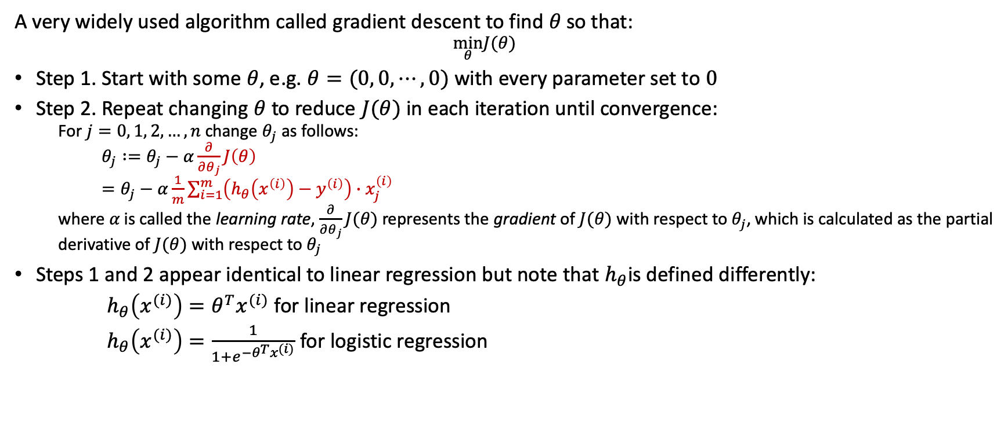
Gradient Descent for Logistic Regression
A very widely used algorithm called gradient descent to find $θ$ so that:
  $$\min_{θ}J(θ)$$
Step 1. Start with some $θ$, e.g. $θ=(0, 0, ⋯, 0)$ with every parameter set to $0$
Step 2. Repeat changing $θ$ to reduce $J(θ)$ in each iteration until convergence:
  For $j=0, 1, 2, …, n$ change $θ_{j}$ as follows:
  $θ_{j} :=θ_{j}−α\frac{∂}{∂θ_{j}}J\left(θ\right)$
  $=θ_{j}−α\frac{1}{m}\sum_{i=1}^{m}{\left(h_{θ}\left(x^{\left(i\right)}\right)−y^{\left(i\right)}\right)∙x_{j}^{\left(i\right)}}$
  where $α$ is called the learning rate, $\frac{∂}{∂θ_{j}}J(θ)$ represents the gradient of $J(θ)$ with respect to $θ_{j}$, which is calculated as the partial derivative of $J(θ)$ with respect to $θ_{j}$
Steps 1 and 2 appear identical to linear regression but note that $h_{θ}$is defined differently:
$h_{θ}\left(x^{(i)}\right)=θ^{T}x^{(i)}$ for linear regression
$h_{θ}\left(x^{(i)}\right)=\frac{1}{1+e^{−θ^{T}x^{(i)}}}$ for logistic regression

Slide 24
Summary
We have moved onto logistical regression for classification from linear regression
We have covered a set of fundamental concepts and techniques of machine learning, e.g. linear classification, gradient descent, Sigmoid function as an activation function, decision boundary, and how to fit a model and make predictions using a fitted model.
These concepts and techniques are closely related to the other machine learning algorithms that this module will cover.

Slide 25
Next Week
Machine learning workflow
Performance evaluation
Key issues
These additional aspects of machine learning will be applicable to all the other ML algorithms the module covers
The first three lectures have laid the foundations for the whole module enabling students to start group projects from Week 4

Slide 26
References
Chapter 4. Training Models in Hands-on ML

Slide 27
Resources
Logistic Regression using Python (scikit-learn) by Michael Galarnyk on towards data science
  https://towardsdatascience.com/logistic-regression-using-python-sklearn-numpy-mnist-handwriting-recognition-matplotlib-a6b31e2b166a
  This is a tutorial on using logistic regression on two datasets, the toy digits dataset and the MNIST dataset. The tutorial has a good explanation about the four steps a typical classifier in sklearn takes with the Jupyter notebook code provided on GitHub that can be saved raw.

